Slide 1
Cloud Motion Prediction through Attention-Guided Frame Interpolation
Guided by : Dr. Geetha S
Course Name : Digital Image Processing course.
Course Code : BCSE403L
Slot : A2+TA2
Semester : VI
University Name : VIT Chennai
Submission Date: April 24th, 2025.

Slide 2
Team Members
Yash Agarwal (22BCE1044) – yash.agarwal2022b@vitstudent.ac.in
Mehul Dhingra (22BCE1008) – mehul.dhingra2022@vitstudent.ac.in

Slide 3
Problem Statement
Web Map Services (WMS) often provide satellite imagery at fixed intervals, such as every 30 minutes, which limits the ability to visualize rapidly evolving and deformable phenomena like cloud movement. This coarse temporal resolution results in choppy animations that hinder effective interpretation. While commercial platforms like Mapbox offer built-in support for video overlays, implementing similar functionality using open-source libraries like OpenLayers or Leaflet is non-trivial and lacks native support. Additionally, no integrated solution currently exists that combines AI-based frame interpolation with real-time, browser-based visualization on open-source WebGIS platforms.

Slide 4
Proposed Solution
We propose the development of an AI-powered system that generates smooth, high-temporal-resolution animations from low-frequency satellite imagery by interpolating intermediate frames (e.g., generating one frame per minute from 30-minute intervals). This video output will be seamlessly integrated into a browser-based interactive map using OpenLayers (version 6 or higher), enabling users to visualize dynamic phenomena like cloud motion in a fluid and continuous manner. The system will support OGC-compliant WMS services and be optimized for WebGIS platforms such as VEDAS, MOSDAC, and BHUVAN. Optional use of on-device GPU/NPU acceleration will be explored for enhanced performance on modern desktop and mobile devices.

Slide 5
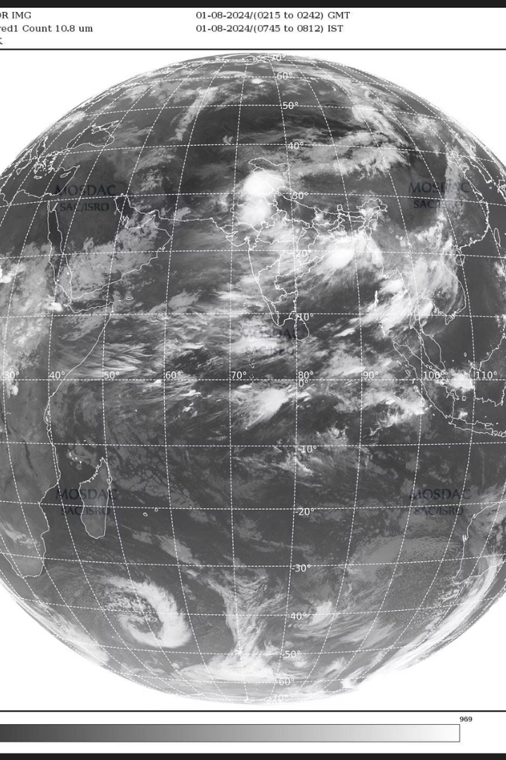
Introduction
Cloud motion prediction is vital for weather forecasting, disaster monitoring, and environmental analysis. This research introduces the Flow Enhanced Interpolation Network (FEIN), a deep learning framework that uses attention-guided autoencoders to predict intermediate satellite frames with high temporal and spatial fidelity. FEIN integrates satellite imagery and wind vector data to model complex cloud movements influenced by atmospheric dynamics.
By combining visual and meteorological cues, FEIN advances satellite-based frame interpolation, enabling real-time visualization and prediction of cloud dynamics with improved accuracy and realism.

Slide 6
Introduction to FEIN and Dataset Overview
FEIN Architecture
Dataset Preparation
FEIN uses a dual-branch autoencoder with attention mechanisms to process satellite images and wind vector maps independently. It captures spatial-temporal features and fuses them to generate realistic intermediate frames.
Over 10,000 satellite images and wind maps were curated, resized to 256×256 pixels, and converted to grayscale. Wind arrows were converted to 2D vector fields aligned with infrared images for synchronized training.

Slide 7
Dataset Description
For this study, a custom dataset of over 10,000 satellite images was curated to support the development of a wind-aware frame interpolation model. The dataset includes two key types of imagery: (i) infrared brightness temperature (BT) images from the Asia Sector, which reveal cloud and temperature dynamics, and (ii) graphical wind maps showing direction and magnitude. Each image pair was resized to 256×256 pixels, converted to grayscale, and normalized to a [0, 1] range. Wind arrows were algorithmically converted into 2D wind vectors using trigonometric decomposition, generating dense vector fields aligned with corresponding infrared frames. Spatial and temporal alignment ensured that each pixel represented the same geographic location across both modalities. Data was organized into triplets—two sequential infrared frames (30 minutes apart) and one wind vector field—captured as NumPy arrays. This structure enabled the model to learn motion patterns and environmental dynamics critical for interpolating realistic intermediate satellite frames.

Slide 8

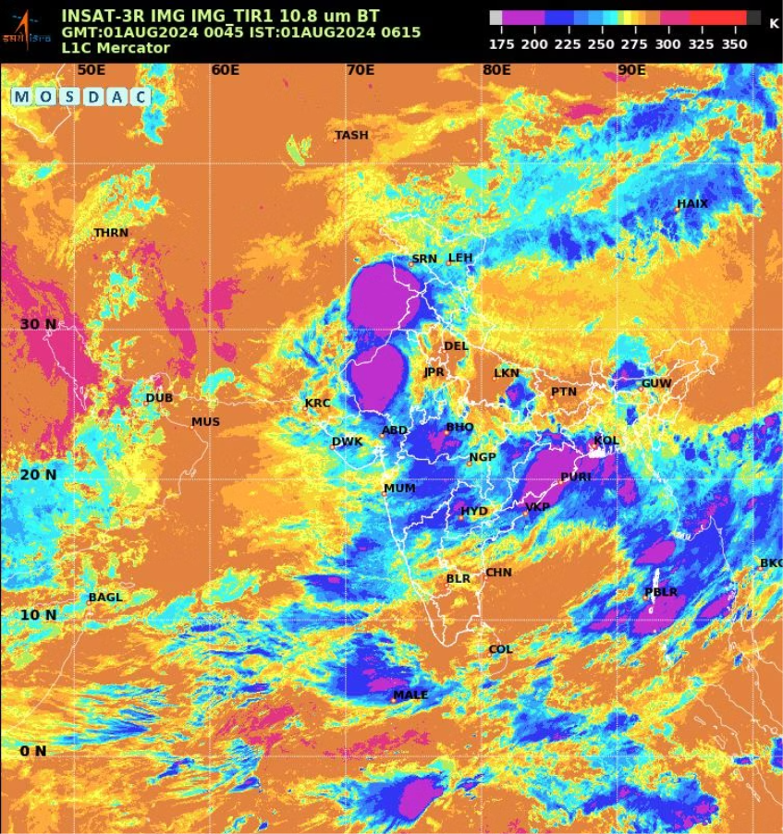
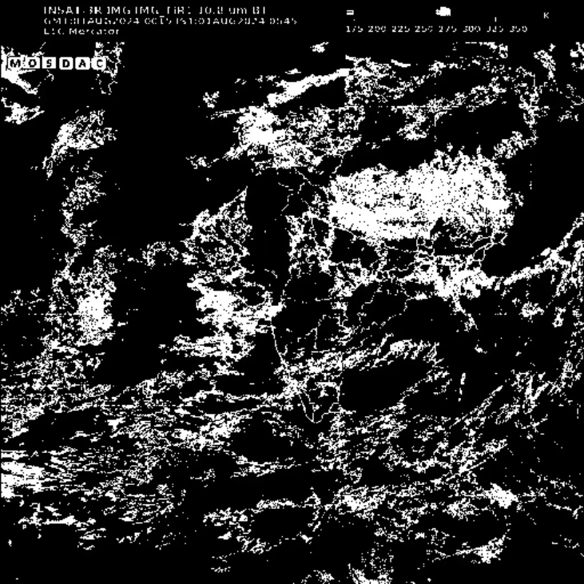

Slide 9
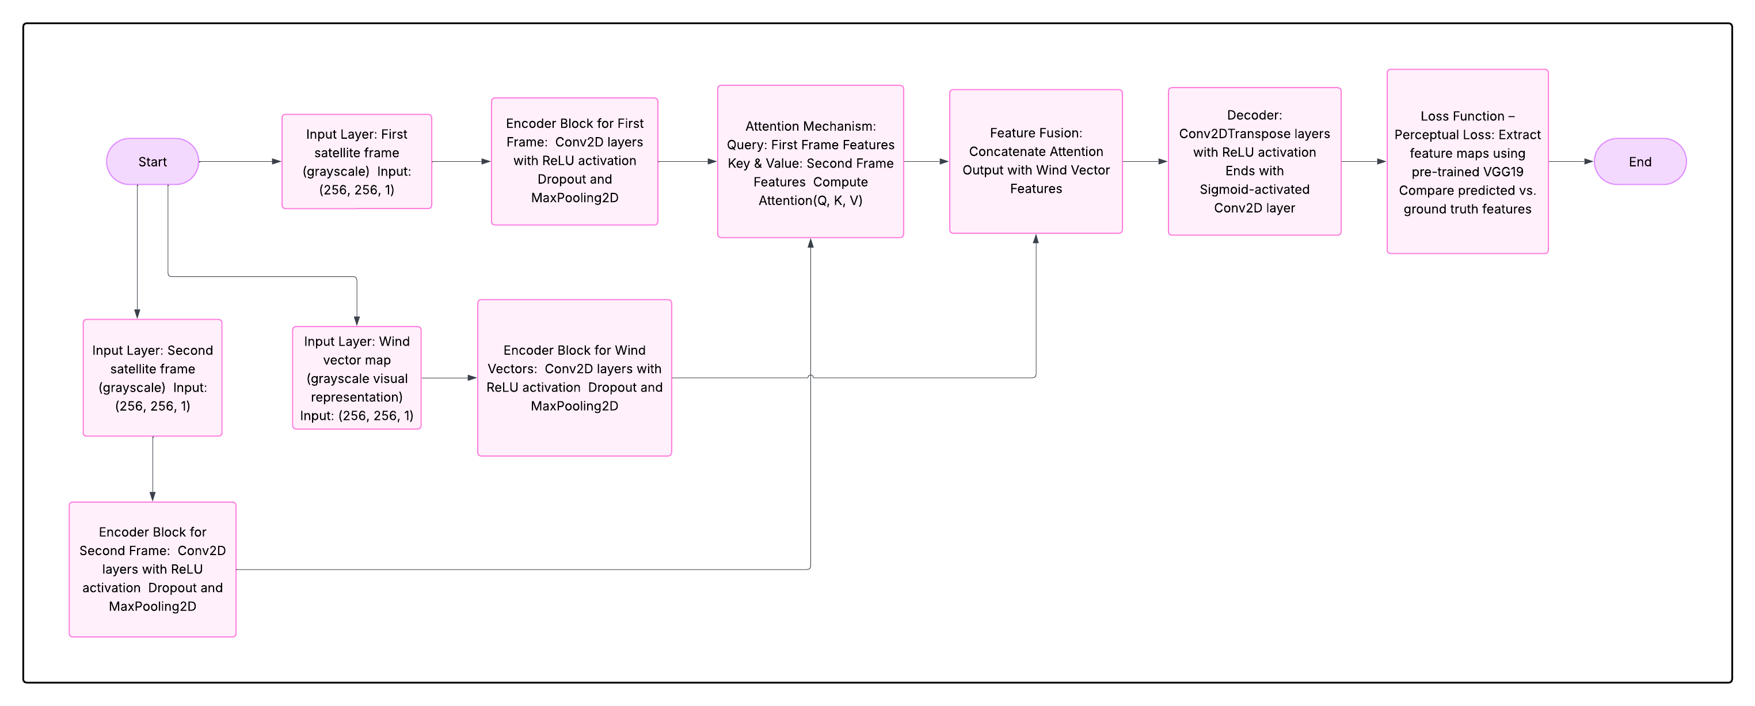
Model Architecture and Attention Mechanism
Multi-Input Encoders
Self-Attention Module
Decoder Fusion
Separate convolutional encoders extract features from satellite images and wind vectors, capturing visual and physical cues.
Concatenates attention-enhanced image features with wind data to reconstruct intermediate frames that reflect real atmospheric motion.
Focuses on regions with significant temporal changes, enabling the model to learn non-linear cloud dynamics effectively.
Architecture

Slide 10




Specialized Frame Interpolation Model
Traditional models assume clouds travel in straight lines, but clouds often move unpredictably. FEIN integrates wind speed and direction data, modeling wind as a flow field aligned with satellite images.
This fusion helps predict complex cloud motions under varying weather conditions, enhancing forecast accuracy during dynamic events like cyclones.
Data Alignment
Synchronizes wind vector maps with satellite frames for coherent input.
Flow-Guided Interpolation
Uses wind flow as guidance to predict intermediate cloud positions.
Loss Computation
Combines pixel-wise reconstruction and flow consistency losses for precise learning.
Training Strategy
Trains on synchronized datasets to balance spatial fidelity and temporal coherence.

Slide 11
Feasibility and Scalability
Realistic Cloud Motion
Scientific Value
Scalability & Viability
Our model uniquely integrates multiple environmental factors, including wind speed, direction, and temperature variations, to achieve highly precise frame interpolation of cloud movements. This holistic approach ensures that the predicted cloud trajectories closely mirror real atmospheric dynamics, even in complex weather scenarios.
By smoothing and enhancing infrared satellite data, the model enables researchers to visualize cloud patterns and atmospheric phenomena with improved clarity and temporal resolution. This enhancement supports deeper scientific analysis, facilitating more accurate weather forecasting and climate studies.
The model is designed to support diverse real-world applications such as monitoring forest fires and severe weather events. Leveraging scalable cloud computing resources, it can perform real-time processing of satellite imagery, making it viable for integration into operational weather prediction systems and emergency response frameworks.

Slide 12
Challenges & Risks in Frame Interpolation
Interpolating deformable clouds is difficult due to shape changes and transient appearances.
Model accounts for these complexities by integrating additional environmental factors.
High processing power needed; on-device GPUs and NPUs improve performance significantly.
Using advanced hardware reduces estimated time of arrival (ETA) by 32.7% for faster results.

Slide 13
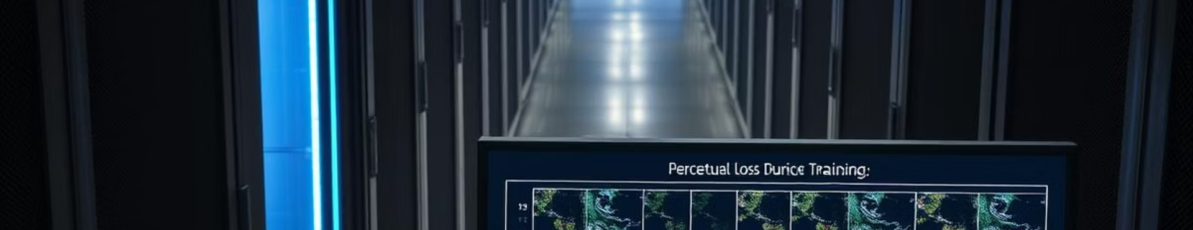
Loss Function and Training Strategy
Perceptual Loss
Training Setup
Deployment
Uses VGG19 feature activations to ensure generated frames maintain structural and textural fidelity beyond pixel-wise similarity.
Trained for 50 epochs with Adam optimizer, batch size 64, and 20% validation split, showing stable convergence and generalization.
Lightweight and modular design suitable for cloud platforms and real-time meteorological applications.

Slide 14
Discussion: Model Strengths and Innovations
Multimodal Integration
Attention Mechanism
Perceptual Loss Benefits
Combines satellite imagery with wind vector data to model cloud motion more accurately than appearance-based methods alone.
Enables selective focus on changing regions, capturing localized and distributed cloud dynamics effectively.
Improves visual realism by preserving fine details and structural integrity, essential for meteorological use.

Slide 15
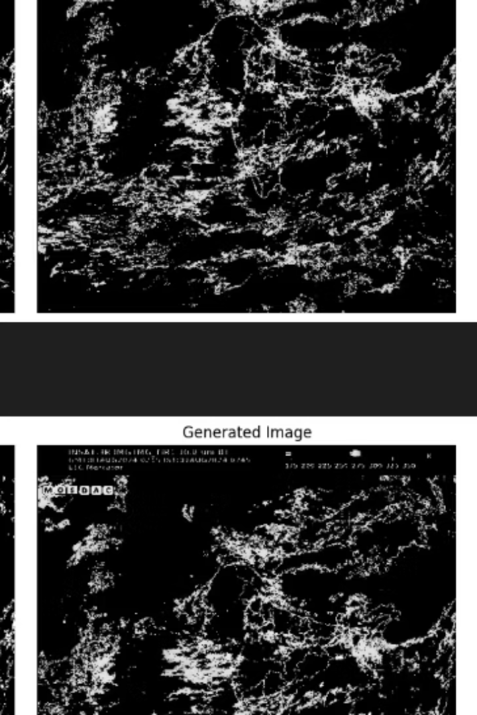




Evaluation of Competing Deep Learning Models
Baseline CAE
Reconstructs coarse structures but lacks fine texture and smooth transitions.
GAN-based Model
Produces sharper images but sometimes introduces spatial artifacts.
ConvLSTM
Captures temporal continuity but struggles with fine spatial details.
Variational Autoencoder
Maintains global coherence but outputs appear washed out and require longer training.

Slide 16
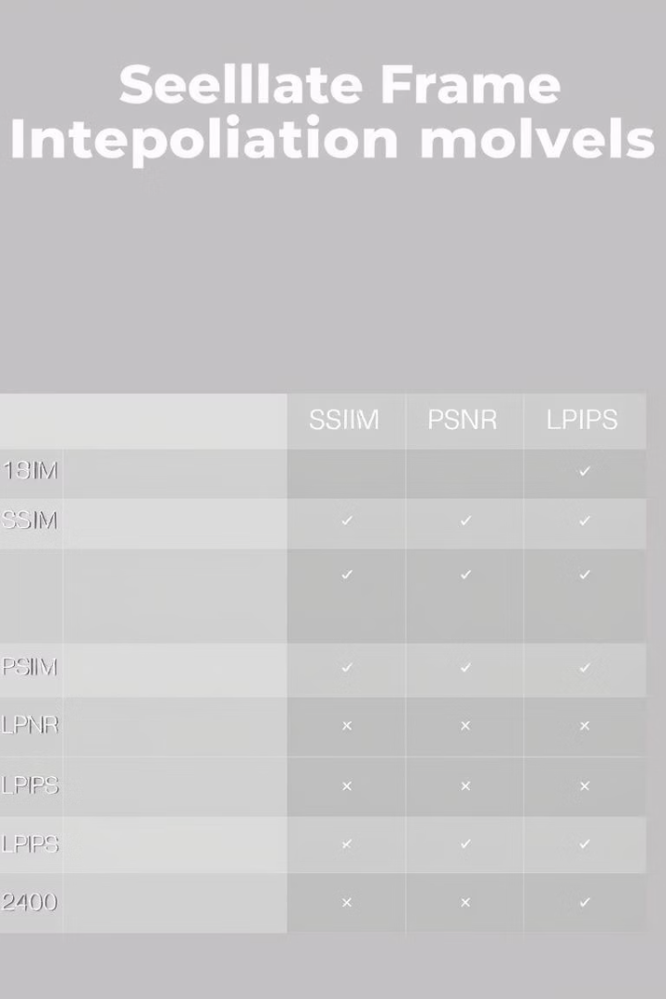
Performance Metrics and Quantitative Results
Model
SSIM ↑
PSNR (dB) ↑
LPIPS ↓
Baseline CAE
0.791
24.21
0.211
Proposed CAE + Attention + Wind
0.864
26.74
0.128
GAN-based Frame Interpolation
0.851
25.93
0.140
ConvLSTM Autoencoder
0.839
25.48
0.149
Variational Autoencoder (VAE)
0.803
24.75
0.175
The proposed model achieves the highest SSIM and PSNR scores and the lowest LPIPS, indicating superior perceptual and structural fidelity compared to other architectures.

Slide 17
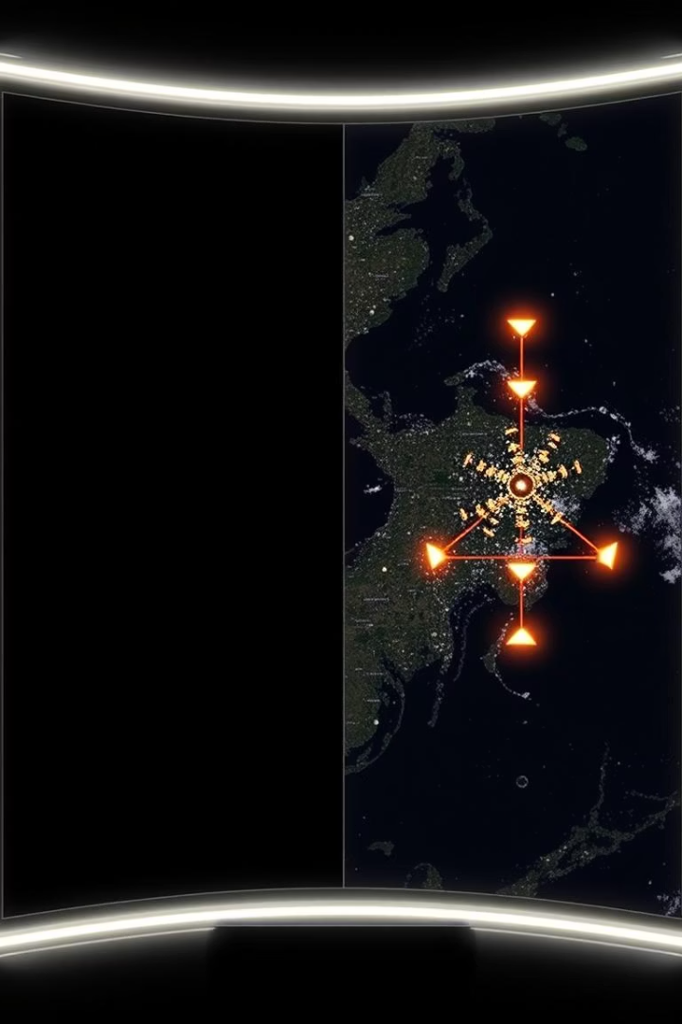
Study and Component Impact
Self-Attention Importance
Wind Vector Integration
Removing attention reduces the model's ability to focus on dynamic cloud regions, degrading output quality.
Excluding wind data diminishes spatiotemporal reasoning, leading to less physically accurate frame predictions.
Combined Effect
Both components are critical for achieving high-fidelity, realistic satellite frame interpolation.

Slide 18
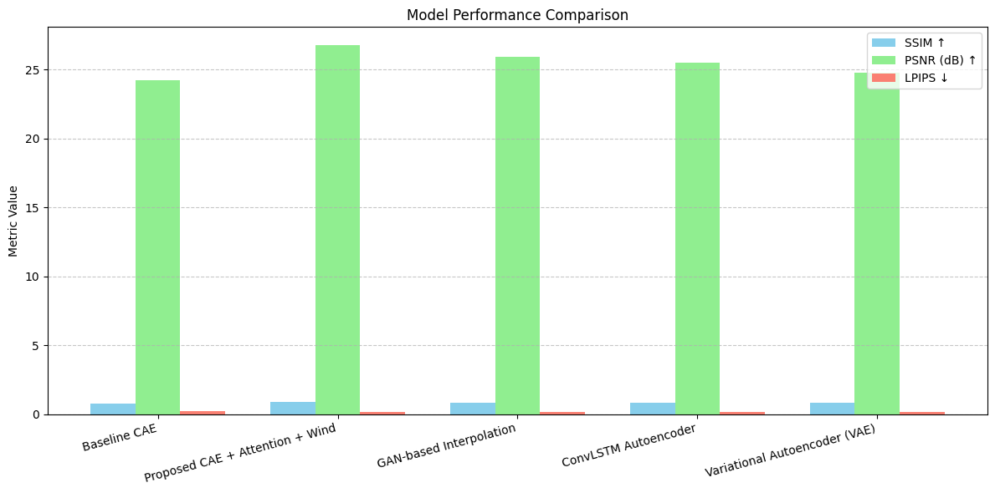
Computational Efficiency and Practical Deployment
Training Time
Baseline CAE trains fastest (~0.5 hrs), VAE longest (~17 hrs), proposed model balances accuracy and efficiency (~1 hr).
Prediction Speed
Proposed model predicts intermediate frames in about 1 minute, suitable for real-time meteorological applications.

Slide 19

Conclusion and Future Directions
Real-World Impact
Superior Performance
Facilitates advanced satellite-based weather forecasting and environmental monitoring with scalable and practical deployment capabilities.
Innovative Integration
Demonstrates outstanding visual fidelity and physical realism, surpassing existing models as confirmed by quantitative evaluations.
FEIN uniquely combines attention-guided autoencoders with wind vector data to achieve precise cloud motion prediction.

Slide 20
Dataset and Service References
Leaflet: Open-source JavaScript library for interactive maps and geospatial data.
MOSDAC Dataset: Satellite data source providing meteorological observations and imagery.
Web Map Service (WMS): Standard protocol for serving georeferenced map images over the internet.
These services enable integration and visualization of accurate weather data layers.

